Slide 1


Professional Growth
Making a difference by being different
A different approach
Problem Statement
The Maps and Pathways Approach
Appraisals/Professional Growth Meetings
Reporting and beyond the basics
Proposed Guidance for everyone
Listening Staircase model
Reflective Learning & models
Proposed Guidance for appraisers
Conversational approaches and strategies
Listening for Change model
Feedback models

Slide 2
Problem Statement
Commonly recognised challenges
Many people do not like or enjoy appraisals, often finding them demotivating;
People see little value in them beyond confirming whether they will increment;
They are often more about compliance than professional growth and career progression;
Usually viewed and experienced as low frequency, high stakes;
Focus always on "what has been done" with little or no attention given to "how it was it done"
Can be a heavy admin burden associated paperwork and preparation;
There is little or no way to "calibrate" between different line managers' approaches to appraising their direct reports
They generate little management information and no business intelligence to support talent management, succession planning and understanding the mix of functional/dysfunction turnover and retention
Consequently, given that everyone one has an appraisal style meeting and every appraisal style meeting has at least two people in it, the number of person hours given over to appraisal style meetings is enormous.
Depending on how many of the bullet points above you recognise, the process is probably a net "destroyer" of value for the Trust, rather than growing or unlocking it.
Maps and Pathways aims to solve all the above problems

Slide 3
The Maps and Pathways Approach
The underlying principles of our approach to solving those challenges are:
The process should be as visual and accessible as possible and not differentiate between teaching and support staff;
It should focus on professional conversations, development and, where desired, career progression;
It should provide a wide range of tools and features to support development and progression which should be flexible, intuitive and configurable.
It should provide genuine valuable management information and business intelligence;
It should allow the organisation to be able to calibrate how different managers are approaching appraisals;
It should be easily and fully configurable, down to the words and terminology used throughout the system, to ensure it aligns with and adapts to the Trust's culture;
Development is driven by customer feedback.
The current and planned system features are listed below:
Discovery & Reflection
Insight & Intelligence
Growth & Progression
Appraisal/PGM
Heat Mapping
& Calibration
Training & CPD Records
Expressions of Interest
360 Feedback
Data Exporting
Competency Frameworks
Johari/Reflective Windows
Reporting Dashboards
Learning Management System (LMS) [Jun-26]
Psychometrics & Traits [May-26]
Organogram [Aug-26]
Career Pathways [Jul-26]
Exit Interviews [May-26]
AI Insights [Oct-26]
Talent ConneXions [Sep-26]

Slide 4
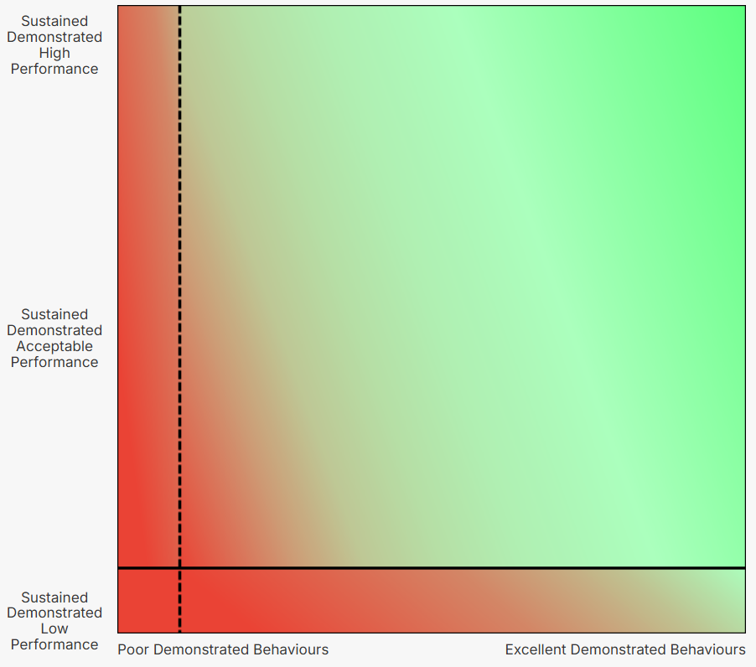



Appraisals/Professional Growth Meetings
Our concept and approach
Our approach consider two specific aspects:
performance axis (Y-axis); what people are doing
behaviours axis (X-axis); how they are doing it
3rd Step
There are 3 Steps to the appraisal process:
1st Step
1st Step – The appraisee places where they think they are on the map and explains their reasoning and how they are currently feeling.
2nd Step
Plan the journey
2nd Step – The appraiser places where they think the appraisee is on the map. Both discuss the gap in terms of both performance and/or behaviours and then explore this.
Discuss the gap
3rd Step – The appraiser and appraisee jointly agree where they would like the appraisee to be, the goal. Discuss the journey from where they are to where they would like to be.
Configuration: All terminology on the diagram to the right is configurable, i.e. "Unacceptable conduct" rather than "Poor Demonstrated Behaviours", "Aim" rather than "Goal", these can be tailored as desired.

Slide 5
Guidance on Marker Placement
A subjective or objective approach can be taken when placing the circles. An approach that some trusts have found useful is having some examples of comments that could be said (but quite clearly not what needs to be said in any or every case) along the two axes:
performance axis (Y-axis); and
behaviours axis (X-axis)
To clarify again, these are examples of comments that could be said to describe a person at various positions on each axis, these are not requirement for what must be said.
This is "a way" rather than "the way" of providing a guidance framework for placement and each organisation will be different on the continuum of subjective to objective.

Slide 6
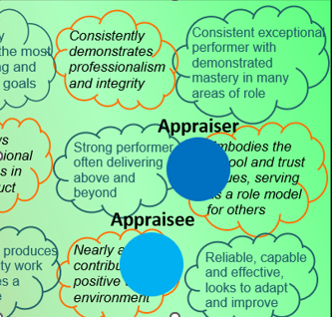
Guidance on Marker Placement
Continuing from the previous page, those example comments could be laid out on the appraisal map in the example shown on the right. They indicate what comments could be made depending on where the markers were placed during the appraisal meeting.
For example, someone with their circle in the top right corner might have the following sort of comments made about them, but equally there might be other positive comments that apply to them.

Slide 7
Further Considerations: Marker Placement
The performance axis (Y-axis); is relative to each person’s job description, career level expectations etc.
Main Scale 3 teacher
So, as an illustrative example (ignoring the Y-axis for a moment):
a Main Scale 3 teacher;
and a UPS 2 teacher
who were performing in absolute terms at the same level might be placed like this:
UPS 2
teacher

Slide 8
Person A: Assistant Head
Further Considerations: Marker Placement
The performance axis (Y-axis); is relative to each person’s job description, career level expectations etc.
As another example of how this might change with promotion for Person A:
as an Assistant Head, person A might have been placed here:
but 6 months later in their appraisal as a newly promoted Deputy Head, they could likely to be placed here.
Person A: Deputy Head
Although their performance will be better in absolute terms, as a new Deputy Head (as opposed to a very experienced Assistant Head) they are likely to be performing less well relative to the more exacting and demanding criteria and expectations of Deputy Head, that they are now assessed against.
This would be expected to change over time as they built up the skills, knowledge and experience with the new, more senior role and the placement of the marker would hopefully be higher as performance improved relative to the new job description.

Slide 9
Contextualising Performance
Consideration needs to be given when assessing against the performance axis (Y-axis); whether this is contextualised by environment factors or not – this is an organisational decision that will then drive the guidance that is given.
As an analogy, two people have to deliver 50 parcels.
Marker placement with Relative Approach
Person B:
Person A delivers 25 parcels and the experienced no issues during their delivery run.
Person B, also delivered 25 parcels but they did this despite the fact that their vehicle broke down during the route and a road was closed with flooding.
Marker placement with Absolute Approach
Person A:
Both have performed the same in absolute terms against expectations, but under very different circumstances. An illustrative example:
Person B:
Absolute Approach to performance: With an “absolute” approach to the assessment of performance, with no consideration for context, they might be placed like this:
Relative Approach to performance: With an “relative” approach to the judgement of performance with consideration for context, they might be placed like this:
Marker placement with Relative Approach
Person A:

Slide 10
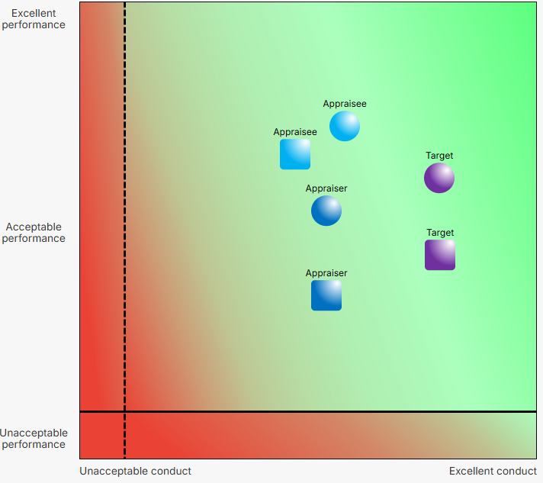
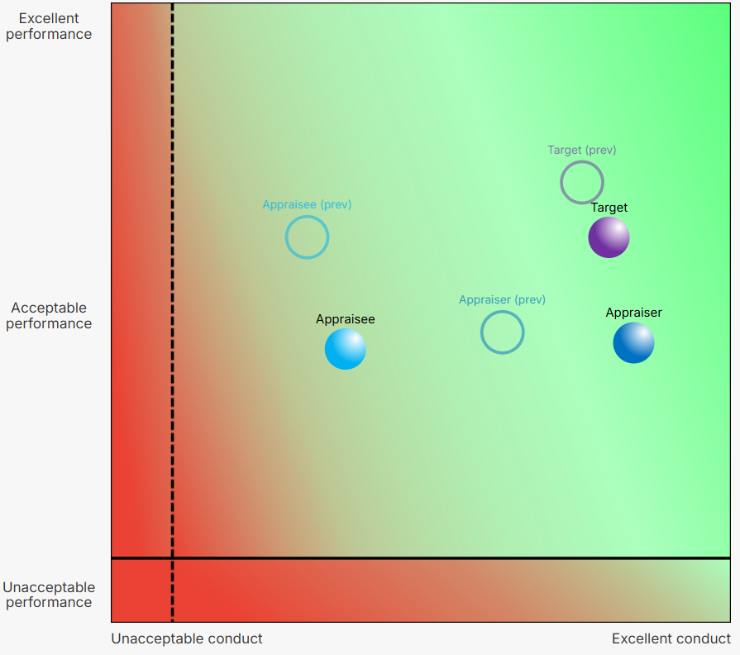
Other Available Elements of Professional Growth Meetings
Up to two roles and two appraisers per person
View previous marker placement
Each person can have up to two roles (i.e. Science Teacher and Head of Year, or Assistant Head and SENDCO) captured within the same Professional Growth Meeting, with two sets of markers (a set of 3 circles and a set of 3 squares) available to enable differentiation of the roles.
Each person can also have up to two different appraisers. The Professional Growth Meetings can be conducted jointly or separately depending on what is most appropriate.
Where a previous professional growth meeting has taken place, the placement of the markers from that previous meeting can be toggled on and off allowing the appraiser and appraisee to see the relative progression from one meeting to the next.

Slide 11
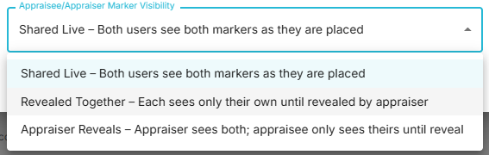
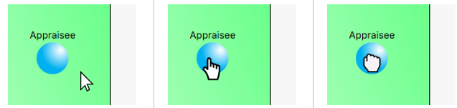
Other Available Elements of Professional Growth Meetings
Revealing the Markers
Remote and in-person meetings
It is possible to change how the markers are revealed. Some organisations prefer the appraiser and appraisee to place their markers before-hand and they are then revealed in the meeting. Some trusts prefer them to be placed during the meeting itself.
The system is set out to accommodate remote and in-person meetings.
For remote meetings, while participants may be on Teams/Zoom etc together, there is no need to share the screen if both are logged into the system as any movement/placement of the markers is visible in real time to all other participants.
Any text typed into the Notes pages (see next page) will also appear in real-time to all other participants.
Where meetings are in-person, if all participants have their laptops with them, they can all interact with the same instance of a Professional Growth meeting in real-time. In this instance only the appraisee can place the appraise marker, only the appraiser can place the appraiser marker, while either can place the third marker (typically goal/target/aim etc).
Or they can switch to "single device mode", if they are using only a single laptop. In this case all three markers are able to be placed regardless of whether it is the appraiser or appraisee's laptop that is being used.
When "single device mode" is enabled, other people involved in that Professional Growth Meeting will receive an email notification informing that this has been enabled.
Moving and Resetting the Markers
All markers once initially placed with the click of a mouse can be moved by dragging them into a new position with the mouse. Alternative there is a "reset" button for each individual marker.

Slide 12
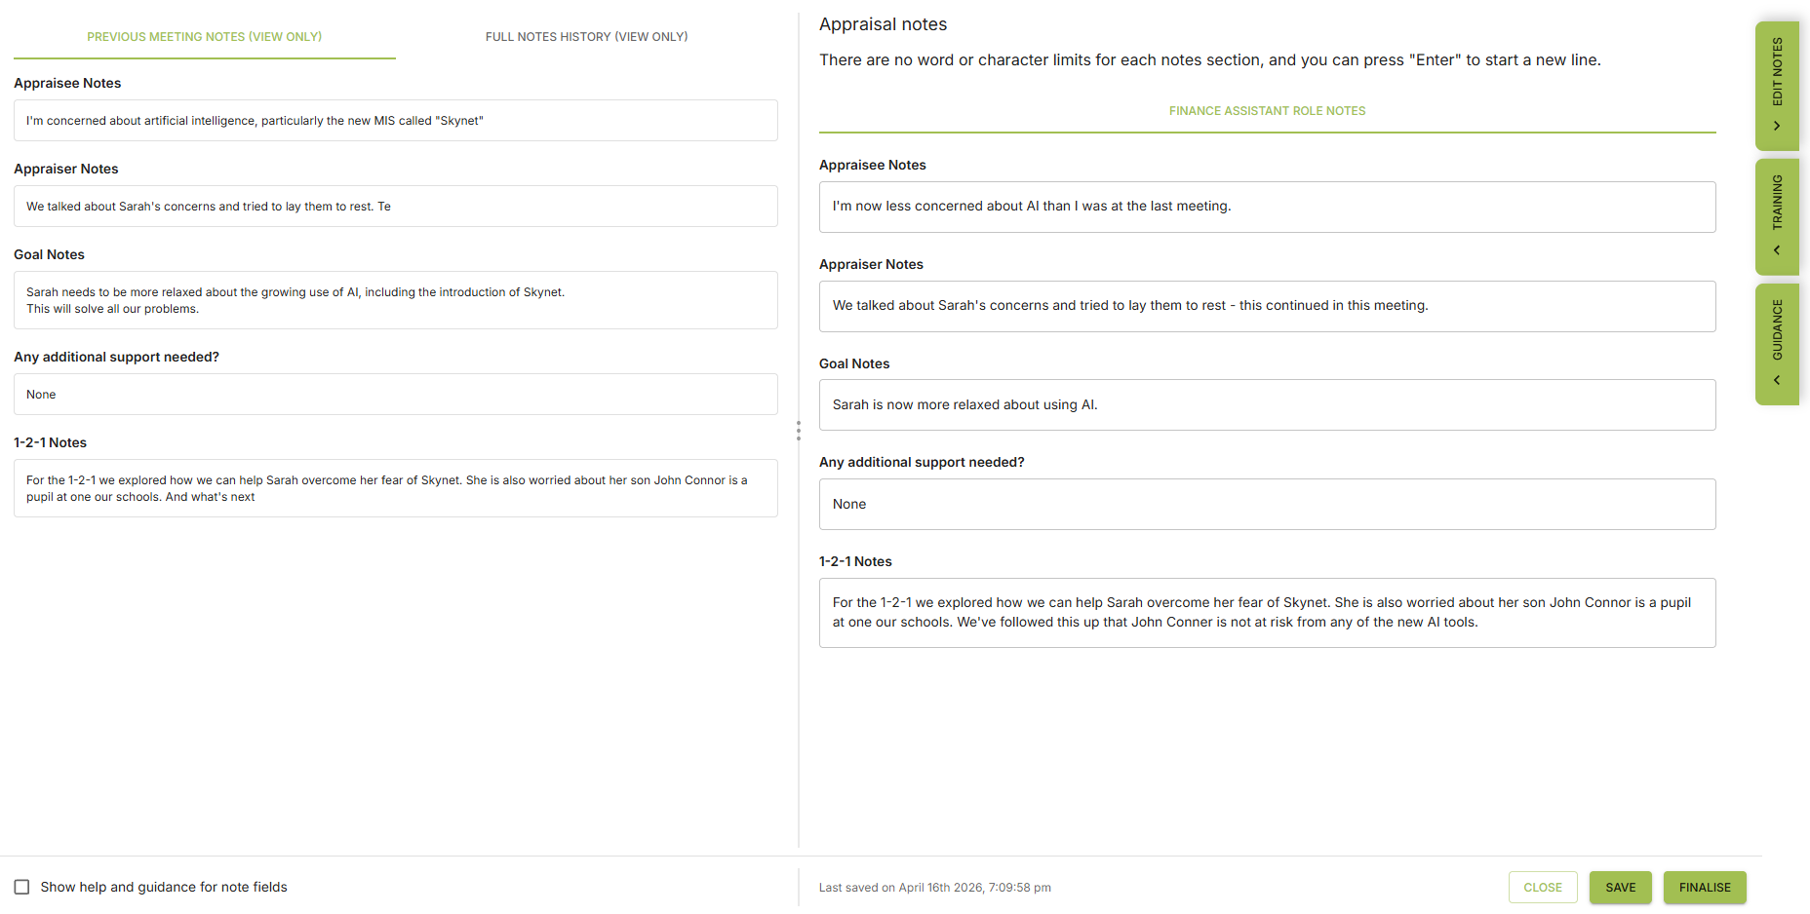
Other Available Elements of Professional Growth Meetings
Capturing Notes from the Discussion
Notes can be captured by both the appraiser and appraisee, before, during or after the Professional Growth Meeting. The Notes automatically roll forward into subsequent meetings, meaning you don't need to copy them while also allowing you to edit them while the record from the previous meeting is still maintained. Notes can be downloaded in full or in part as a PDF file.
Configuration: The Notes are fully configurable in terms of:
How many different headings;
What those headings are called;
Whether they are free text, drop down menus, check boxes, document uploads, headings or URL links;
They can individually be made as required or optional fields

Slide 13
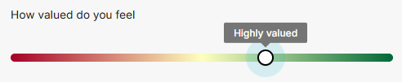

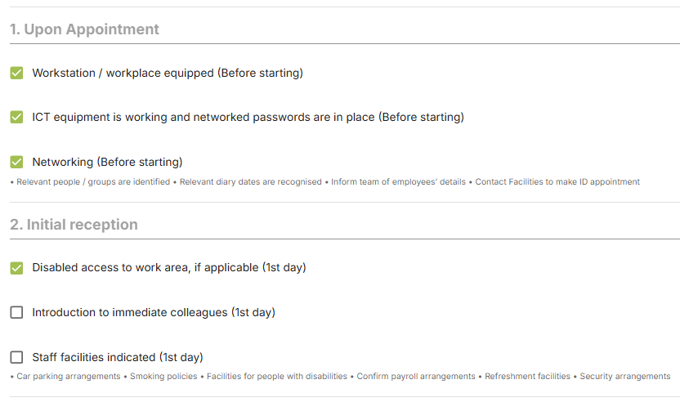

Other Available Elements of Professional Growth Meetings
Different types of Professional Growth Meetings
Sliders for capturing additional aspects
It is possible to have any number of different types of Professional Growth Meetings, one-to-ones or inductions or probationary meetings. Some or all elements of Notes from one type of meeting can also be fed into another, i.e. "one-to-one" Notes could be fed into PGM meetings.
In addition to the placement of the three markers, there is also the option to capture up to three other aspects through the use of three configurable sliders, which also feed into the reporting framework (see later in this presentation).
Configuration: The Notes for each meeting type can be tailored as desired to meet those requirements, i.e. checkboxes for Induction. The need to place the markers can also be turned on or off for each meeting type depending on whether or not they are relevant.
Configuration: The sliders can be turned on or off individually depending on whether none, one, two or all three were used.
The questions/naming of the sliders can be configured, as can the number of steps (the range is from 2 to 11) and the labelling/"call out" text for each step can also be tailored.
The visibility of the sliders to both the appraiser and appraisee can also be configured.

Slide 14
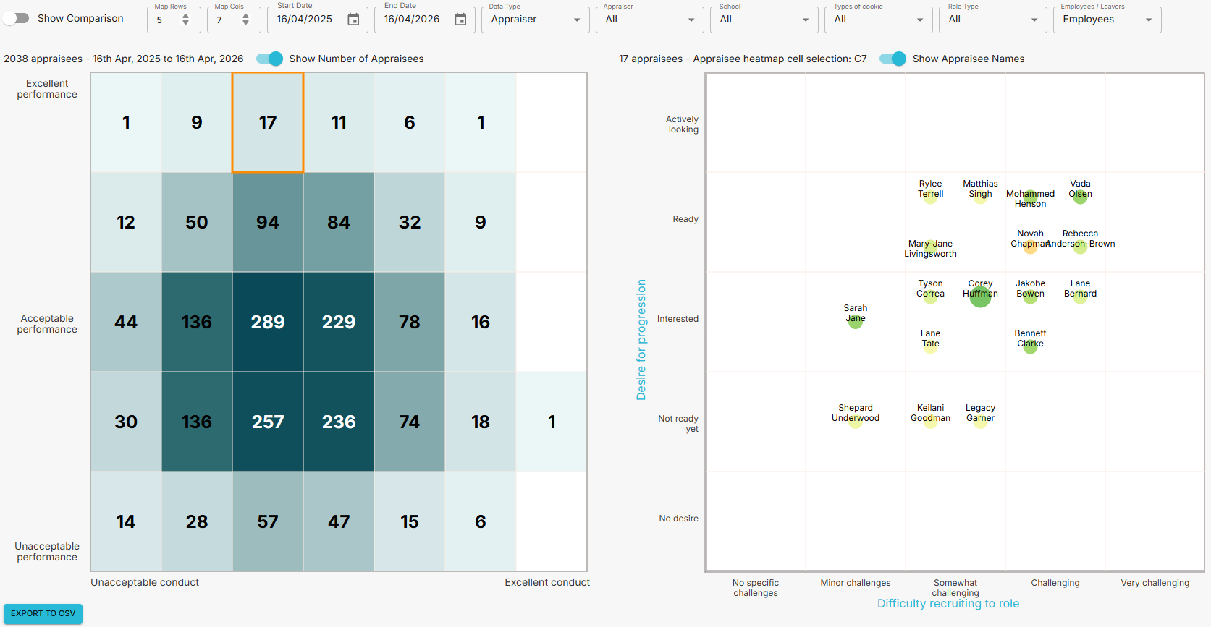

Reporting and Beyond the Basics
The system allows the results of the Professional Growth Meetings to be viewed as a configurable heat map, showing the distribution across the whole or part of the organisation with parametric analysis of staffing data categories as well.
When a portion of the heat map is selected a second array is populated, showing the results of the 3 sliders. The colourised slider defines the colour of the dots, while the other two sliders define the X and Y axes and relative location. Clicking on the dot takes you to the individual's profile.
Configuration: The granularity of the heat map and be configured for the number of rows and columns.
It can return results from a set date range, swap between which of the three markers it reports on, look at heat maps for individual appraisers, schools or staff types.
It can also look at leavers as well to help understand the nature of turnover.
Comparisons between appraisers, schools etc can also be made.
The data is also presented as a table for exporting as a CSV.

Slide 15
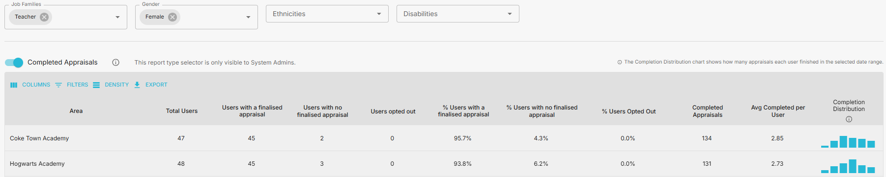
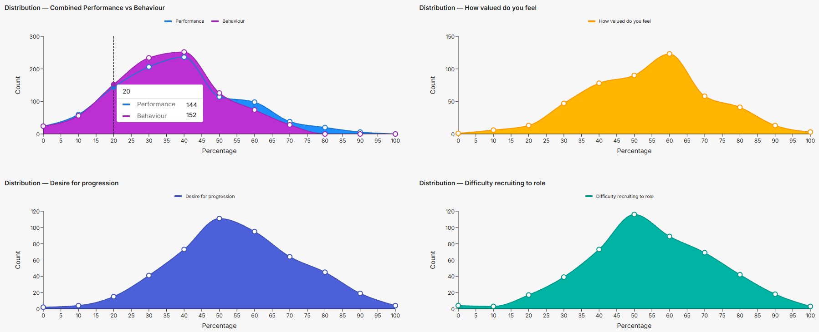
Reporting and Beyond the Basics
The system also allows reporting of results as distribution curves and as table with parametric analysis of whatever data fields (staff type, gender, contract type etc) the trust has chosen to capture as part of user profile data.
Configuration: The data fields that are captured and what the category options within each field are fully configurable. The only required one is Job Families as that feeds into the forthcoming LMS, career pathways and competency frameworks if those functions are used.

Slide 16
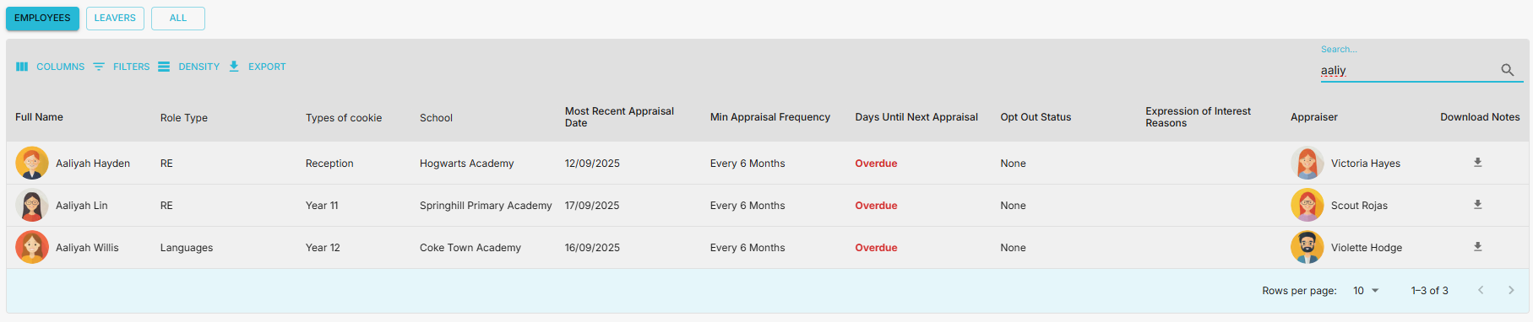
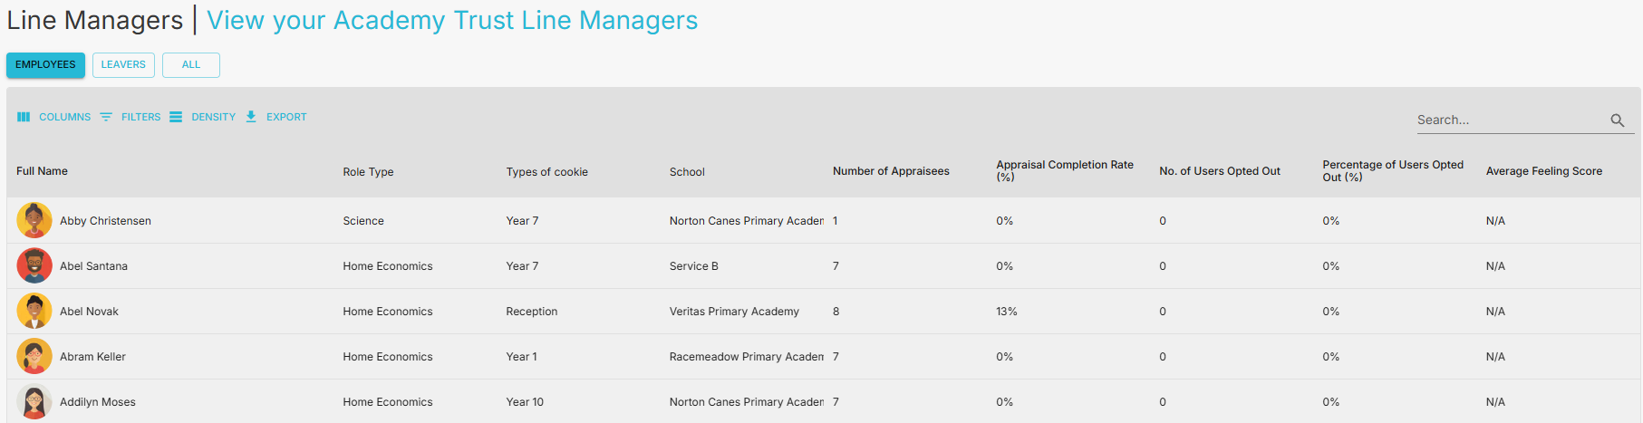
Reporting and Beyond the Basics
Users can be viewed en masse, filtered and searched with varying levels of access set for different groups of staff, such as Line Managers, Headteachers, HR, Organisation Admin etc.
Line Managers can similarly be viewed to see the number of direct reports, completion of appraisals, the number who have opted out (if this option has been enabled by the trust).
Column headings can be re-ordered, re-sized and turned on and off with any changes a user makes persisting.

Slide 17
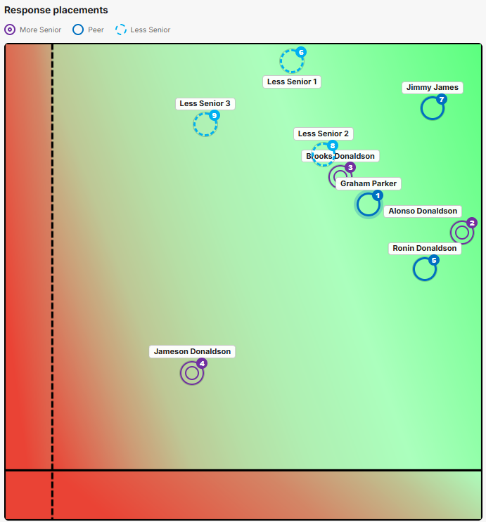
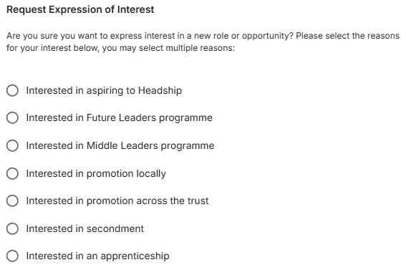
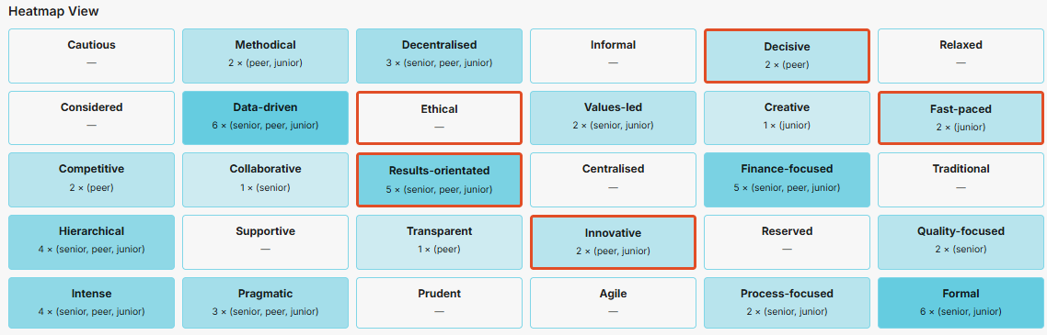
Reporting and Beyond the Basics
Capturing Training and CPD
360 Feedback
The system allows users to log training and CPD and evaluate its effectiveness, uploading certificates and reporting on cost, duration and other categorisations as desired.
360 Feedback requests for individuals, parts of the trust, teams or the whole trust can be configured, set up, managed and viewed with tailorable options around anonymity and written feedback as well as marker placement, distinguishable in up to three different sets of responses (less senior, peers, more senior).
Expressions of Interest
The system allows users make expressions of interest, which could be about promotion, secondments, projects or internally run courses or any other opportunity.
Johari/Reflective Windows
A deeper analysis tool than 360 Feedback, these can be set up to explore an individual's characteristics, or the culture of a team, school or the whole organisation. Templates are included, but as with everything else, it is completely configurable.
Configuration: The number of options and what they say can be tailored, with a free text option available as well.

Slide 18
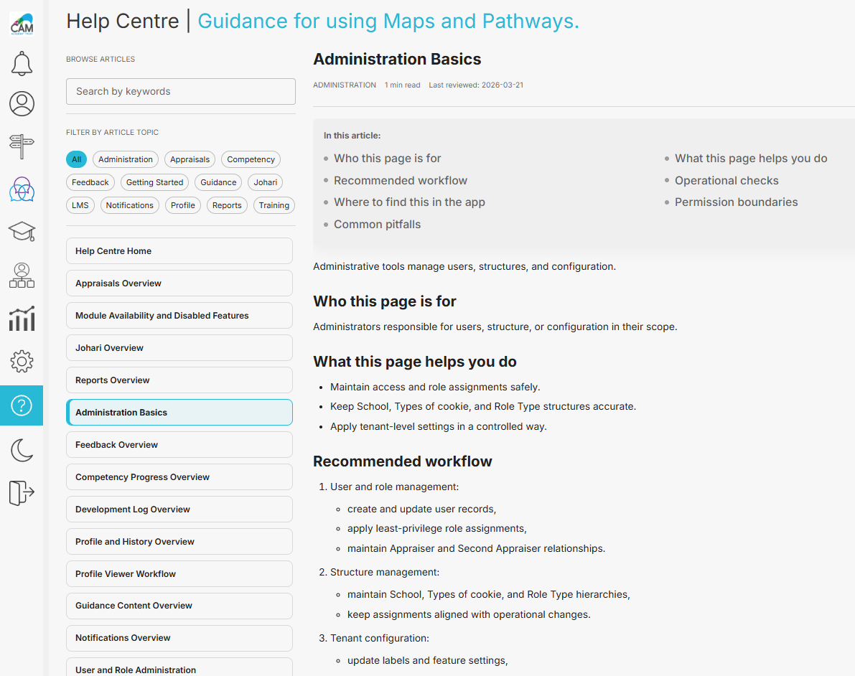
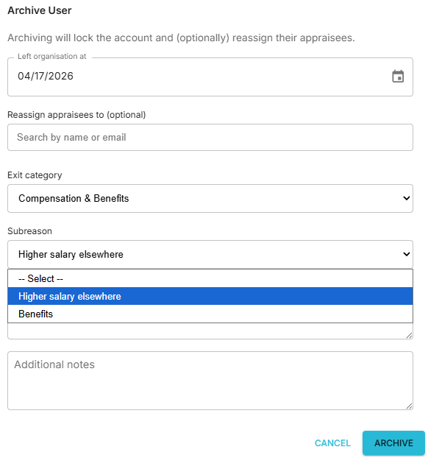
Reporting and Beyond the Basics
Exporting Data
Help and Guidance
All data tables within the system can be exported as CSV files and a full download of all user data can be performed at any point, changes made in excel and then re-uploaded allowing bulk changes (for re-categorisations of data, new data fields being added, schools being added or leaving etc) in addition to making individual changes.
Guidance can be uploaded into the system or linked to external URLs such as Teachers Standards. There is also a dedicated help page with searchable articles and custom videos can be made which reflect the trust's specific configuration of the software.
Leavers
Detailed Leaver information can be captured and direct reports can be easily bulk re-assigned to a new manager. Previous leavers who
rejoin can also be re-activated (subject to the trusts data retention policy) and Exit Interviews captured within the system as well.
Configuration: The categories for leavers can be configured with two different levels of detail allowing comprehensive reporting, allowing genuine understanding of the mix of turnover as well as patterns.

Slide 19
Proposed Guidance for Everyone: Listening Staircase Model
The Listening Staircase Model is a helpful way to visualise the different extent to which someone can listen.
5. Empathetic listening – The highest level of listening. When listening empathetically, we listen to not just to the words and the facts but focus on understanding the message from speaker’s frame of reference. This allows us to shift from “our perception” to “their perspective”. It means trying to see things through the eyes of the person communicating with us. Their feelings, logic and context, why are they communicating this and how do they want you to feel about it. Techniques such as paraphrasing and acknowledging the speaker’s emotions are helpful to ensuring the understanding is shared.
5. Empathetic listening,
Listening for feelings and perspective
As an appraisee or an appraiser, challenge yourself and reflect on which type of listening
you are doing during an appraisal.
4. Active listening,
Listening to understand and engage
3. Selective listening,
Waiting to disagree
2. Pretend listening,
Waiting to speak
4. Attentive listening – The listener is fully focused on the literal content and words of the speaker, paying close attention to what is being said, ensuring factual accuracy. This means that we are concentrating on what is being said and responding appropriately. We will also be using the right body language to show that we are listening.
1. Ignoring,
There, but not present
3. Selective listening – Here we do the same as pretend listing in that we show that we are listening through body language, but we do hear certain parts or engage on occasions. These are times where what is being said interests us.
2. Pretend listening – we may use body language that shows we are engaged and listening to what is being said, but our mind is probably elsewhere – either intentionally or because we have something else to concentrate on. We will eventually get caught out if we use pretend listening because we either have to ask the other person to repeat what was said or, we get a question from them that we can’t answer or an action that we will be unable to carry out.
1. Ignoring – we completely ignore what has been said, our body language likely shows this is the case too. For example, we may look away, do something else and not engage with the person who is communicating with us.

Slide 20
Proposed Guidance for Everyone: Reflective Learning
A key element of successful appraisals, and successful careers, is the use of reflective learning.
Reflective learning is the skill or process of gaining insight or knowledge from an experience. Individuals consciously and purposefully look back at a specific experiences, activities, or ideas, and critically analyse them to gain insights and improve future actions. It is the intentional process of turning an experience into genuine learning and goes beyond simply remembering with the focus on understanding and evaluation.
It helps:
Improve self awareness: Identify personal strengths, weaknesses, and preferred learning styles.
Bridge theory and practice: Connect academic knowledge and principles to real-world situations.
Improve Critical thinking: Move beyond simply recounting events to analysing the underlying causes and implications.
Facilitates continuous improvement: Turn mistakes and successes into successful personal and professional development to improve things in the future or share with others.
The systematic use of reflective learning as part of continuous professional development is called reflective practice. There are two ways reflective practice can be used:
1. Reflection-on-action
Thinking after the event. Occurs retrospectively after the experience is complete and involves stepping back to analyse the event, evaluate decisions, and connect practice to formal theory.
This provides deeper Learning, extracting lessons, and formulating plans for long-term professional change.
2. Reflection-in-action
Thinking on your feet. Occurs during the experience. It's the real-time adaptation and adjustment you make as you observe the immediate results of your actions (e.g., a leader noticing the team is confused and immediately changing the communication style).
Immediate Correction and improvisation. It relies heavily on tacit knowledge (unspoken, intuitive expertise). It is the more powerful application but requires high levels of self and situational awareness.

Slide 21
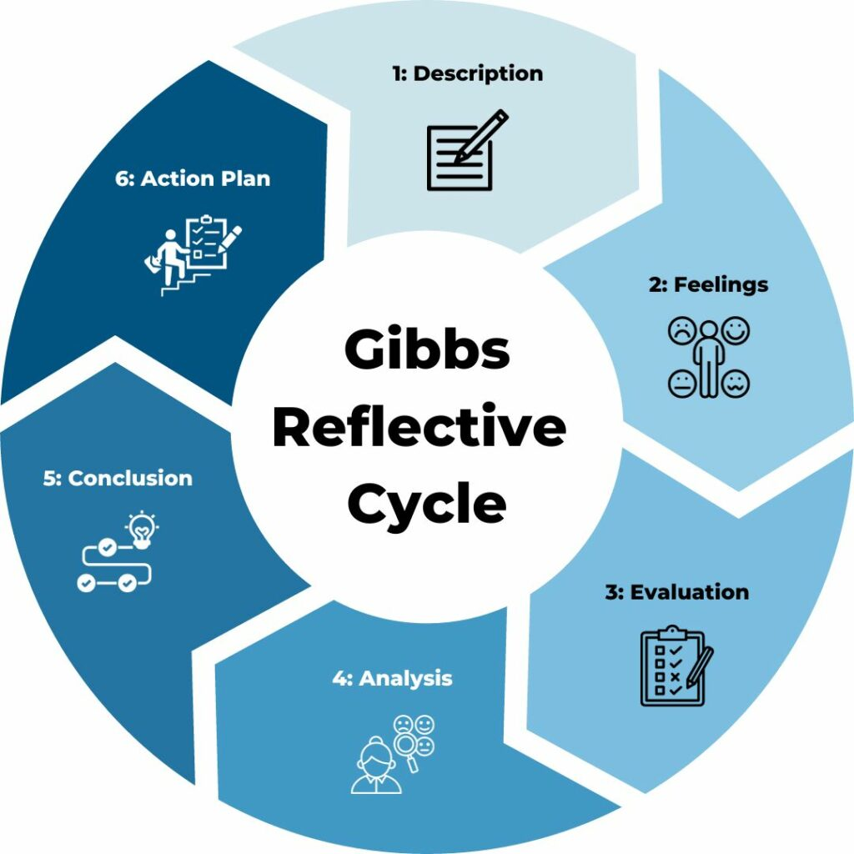
Reflective Learning Models
There are a number of reflective learning models to help guide the process, two are set out the current and next slide:
Gibbs Reflective Cycle
(G. Gibbs, 1988)
1. Description: Detail the event factually: who, what, when, and where. Avoid adding interpretations, emotional responses or judgements. Be clear on the sequence of events, what the original goal and intent was and conclude with what the end result of the situation was.
2. Feelings: Recall your internal reactions and emotions during and after the event. This is focusing on your perception. Then consider the impact on others putting yourself in their shoes. This is focusing on a wider perspective.
3. Evaluation: Be objective here about what was good and bad about the experience. Look at what went well (even if the overall result was poor) and what didn't go as planned. This stage helps you identify the "turning points" of the situation.
4. Analysis: This is the most critical stage for deep learning. Use external knowledge, theories, or past experiences to explain why things happened the way they did, bringing this to consciousness. Example: "The meeting failed because I didn't set a clear agenda, which aligns with XYZ time-management theory."
5. Conclusion: Reflect on your personal performance. Given what you’ve analysed, what alternative steps could you have taken? This is about identifying specific skills or behaviours to change.
6. Action Plan: Create a concrete "cheat sheet" for the future. Outline specific steps you will take to ensure a better outcome next time, such as seeking training or changing a specific workflow.

Slide 22
Reflective Learning Models
The model functions as a roadmap for a coaching conversation, ensuring that the session doesn't just circle the problem but moves toward action:
Goal: Define what the person wants to achieve. This must be specific and measurable, rather than a vague desire to "improve."
Reality: Assess the current situation. This involves exploring the obstacles, the resources already available, and what has been tried so far.
Options/Obsctacles: Brainstorm all possible paths forward. The focus here is on creativity and removing "internal censors" to find multiple solutions.
Way Forward (or Will): Convert the best options into a concrete action plan. This stage establishes commitment, timelines, and accountability.
The GROW Model
(J. Whitmore, 1992)
G | R | O | W
Goal | Reality | Options/ Obstacles | Will
Define where you want to get to | Agree parameters of your situation | Explore options and barriers | Commit towards a forward path
What do you want to achieve? What does your goal look like specifically? How would you define your goal? | What is happening right now? How will your situation impact your goal? What resources are available to you? | What options are available to you? What obstacles do you face? How might these play out and how can you overcome them | How committed are you to your goal? What are the first steps towards it? What would encourage or discourge you?
The power of the GROW model lies in itsability to foster self-awareness and personal responsibility. Rather than a manager or coach simply giving advice, the model uses powerful questioning to lead the individual to their own conclusions. By identifying their own "Way Forward," the individual is statistically much more likely to follow through and achieve the desired outcome.

Slide 23
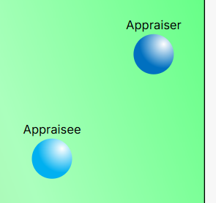
Guidance for Appraisers: Conversational approaches and strategies
Appraisee under rating themselves in terms of performance and/or standards & conduct
This sort of gap is often about either:
Unrealistic expectations
Self confidence
Not wanting to seem over-confident
In this instance, whether for performance and/or standards & conduct, a helpful approach can be to ask the appraisee why they haven’t put themselves somewhere else, rather than where they have put themselves. Example questions could include:
Sometimes, when someone deliberately undermarks themselves in an appraisal, it can be a defensive tactic: they’re reframing the discussion to avoid accountability and shift the appraiser’s role into being a “reassurer” rather than “challenger”. This is often in the desire for a more positive conversation or in hope that the conversation might change to one about self confidence, to avoid the more meaningful conversation about their lower than desired performance and/or standards & conduct.
“I can see you’ve placed yourself lower here. Tell me what led you to that view?”
This opens exploration rather than immediately comforting them.
“I’d like to share some examples I’ve seen — both where things are working well, and where they’re not yet where we need them to be.”
This prevents the employee from steering the dialogue entirely toward confidence and away from accountability.
“It sounds like your confidence affects how you see your performance. At the same time, there are concrete areas where improvement is needed. Let’s look at how we can address both together.”
Avoid letting the conversation become either about self-confidence or poor performance/standards & conduct. Frame it as both
“What steps do you think you can take to raise both your confidence and your performance in this area?”
If the individual tries to steer into reassurance-seeking, gently bring responsibility back to them.
“Talk me through what placing yourself where I’ve placed you would have looked like over last year/time period”
“What more do you feel you would have had to do to feel confident about placing yourself closer to where I placed you?”
“Describe what else you think you would have had to do or what else people would have seen from you that would result in you placing yourself higher and/or more to the right?”
People often cannot describe what that higher performance or better standard & conduct would look like or these questions require them to confront potentially unrealistic expectations. Either way it helps them bring to consciousness the often reflexive thought processes that instinctively make them want to under rate themselves.

Slide 24
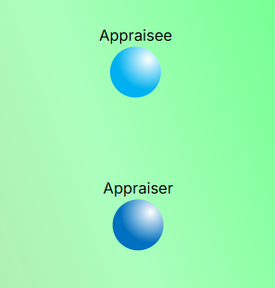
Guidance for Appraisers: Conversational approaches and strategies
Appraisee over rating themselves in terms of performance
This sort of gap is often about either:
Over confidence/blind spots
Mis-under or lack of understanding around expectations/job description/professional standards
Unhelpful overly positive previous appraisals
In these instances it can help to “ask rather than tell” and then gradually bring in contextual examples of what the level of performance where they have placed themselves would look like.
“Do you think there’s any aspects of your performance that haven’t been that high or where you haven’t been consistent.”
This can either encourage them to be more candid and introduce those aspects and bringing them to consciousness will help them re-appraise their position. If they do not, it then creates the space for you to introduce them with examples. Again, where highlighting performance blind spots the follow on is that failing to identify the blind spot is something that would suggest performance is lower in and of itself.
“There’s obviously a gap between how you see this and how I do. What do you think might explain that difference?”
A more open-ended question encouraging them to consider your view.
“Can you give any examples of how your performance could have been even better?”
When they give these examples, you can then suggest that level of performance is what you would consider as being required for them to place themselves where they have, rather than where you have placed them. The conversation is then around calibrating their expectations, potentially given contextual examples of what that higher performance would have looked like.
“It’s good that you feel you’re operating strongly here — confidence is important. At the same time, there’s some examples I’d like to give you where there’s still some development required, which is why I’ve not placed you as high on performance.
More directive and allows for the introduction any examples.
“I see you’ve rated yourself towards the higher end of performance. Can you walk me through the examples that led you to that?”
This requires them to give their reasoning before introducing your perspective.
“I agree you’ve made real progress in delivery against deadlines. At the same time, do you think you’ve also made the progress with accuracy?”
Affirm parts of their self-assessment that are valid, then gently pivot to questioning about areas where there hasn’t been as much progress.
“Do you think there’s any performance criteria/elements of your Job description you haven’t yet considered when you’ve thought about where to place yourself?”
This may help them recognise they’ve taken a purposefully narrower view to arrive at the placement, or if they don’t mention any, it creates the space for you to introduce areas of performance they haven’t considered and highlight that while they have those blind spots it will hinder achieving higher performance.

Slide 25
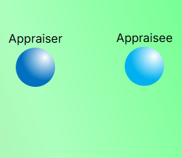
Guidance for Appraisers: Conversational approaches and strategies
Appraisee over rating themselves in terms of standards & conduct
This sort of gap is often about either:
Self awareness/blind spots
Not empathising with others enough
Mis-under or lack of understanding around expectations/values
This conversation is trickier: it’s often tied to self-image, values, and interpersonal blind spots. Sometimes it can be helpful to approach the conversation in terms of talking about “what they think” and “how you/others felt” as often people haven’t thought about how their actions made others feel.
“I can tell that you value being proactive and stepping in to help. That’s important. At the same time, do you think there might have been occasions where others could have experienced that as you taking over rather than supporting them.”
Even if the behaviour hasn’t landed well, while recognising that their intent may have been positive introduce questions around how others might have experienced it.
“Can you think of any other examples where what you intended might not have had the impact you wanted or hoped for in terms of how it made other people feel?
This encourages the exploration of that gap between intent and impact and “what you are transmitting” is sometimes “not what others are receiving”.
“I believe you meant to be supportive in that meeting. The impact, though, was that others felt their input wasn’t being heard. Can you think about other times that might have been the case?”
Gives a statement clarifying the impact but then ends with the question inviting further consideration of other situations .
“What do you need to take in future or what can you do differently to avoid situations like this happening again?”
Open ended question focusing on what needs to change which implicitly recognises that change is required.
Again, “asking” rather than “telling” is important to ensure the conversation functions as an “adult-to-adult” conversation rather than becoming an “adult-children” one. Questioning naturally generates more self awareness of the issues, or initially the self awareness of the need to be more self aware. It can sometimes be about contrasting intent of behaviours vs their impact.
“You’ve rated yourself highly in relation to standards & conduct. Can you share examples where you feel you’ve demonstrated this?”
This gets them to articulate their view, creating space for contrast later.
“Do you feel you’ve demonstrated that consistently through the year/time period?”
This implicitly introduces the possibility for them to consider that there have been occasions where they conduct and standards may not have been as high.

Slide 26
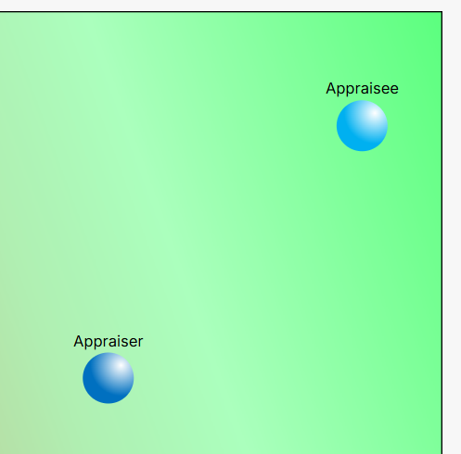
Guidance for Appraisers: Conversational approaches and strategies
Appraisee significantly over rates themselves in terms of performance and standards & conduct
This sort of gap is often about either:
Self-awareness/blind spots
Unconscious incompetence/capability
In this instance, while still focusing on open ended questions there will unavoidably be a need to address the gap and “what that’s about”. It may be helpful to first acknowledge “how they feel” about the gap, before addressing “what they think” about it.
“Do you think the focus of our conversation needs to either be about expectations or self-awareness, or is it a little bit about both?”
Framing the question like this highlights that it is a case or one or the other, possibly both and focuses the response around considering that.
Where there is also a significant gap in respect of standards & conduct many of the suggested questions and approaches on the previous slide apply but with the examples likely being more powerful and the questions being more direct and slightly less open, such as
“What was your intention when you did that (example given)?”
“Why do you think there is so often such a difference between what your intention is and what impact you have?”
Depending on how the conversation progresses and the person’s willingness and ability to accept the difference of view additional tools might need to be brought into the process to bring the blind spots and expectation gaps into consciousness for the person such as 360 feedback or a Johari Window, which might be particularly helpful is there is a large gap in terms of standards & conduct. These are both available in the system.
“I’m conscious that we need to move this forward and while there’s more we can talk about on this, I think exploring some 360 feedback or an exercise around blind spots might be really helpful to giving you a sense of what’s contributing to this gap because until we can acknowledge what is causing it, it’s going to be difficult to close it.
“Let’s acknowledge that there is clearly a gap between our views, is this a surprise for you and how do you feel about it?”
Initial question to acknowledge how they may feel about that in the moment, while also implicitly acknowledging that it shouldn’t be.
“Why do you think there might be such a gap between how we’re viewing your performance and/or standards & conduct?”
“Do you think there would have been the potential for higher performance from you, or do you think there were any barriers or obstacles to that?”
Allows them to frame their performance and gives you the opportunity to challenge what they view as high performance, such as a follow-on question like:
“So that higher performance that you’ve described, I’d view that as being here” (indicating a lower point than they’ve placed themselves even though they’ve just described higher performance than they’ve actually delivered)

Slide 27
Proposed Guidance for Appraisers: Situation, Behaviour, Impact, Intent (SBII) Feedback Model
 | Description | Example
Situation | Describe the situation in which the behaviour occurred. Be specific about when and where it you observed it. The facts are important. Avoid generalities, such as "last week," as that can lead to confusion. | "This morning at the 11 a.m. team meeting."
Behaviour | Describe the behaviour that you observed. Keep to the facts. Don't insert opinions or judgments and don't make assumptions about what the other party was thinking. | "You interrupt me while I was telling the team about the monthly budget," instead of "You were rude."
Impact | Objectively describe the results and impact of the behaviour. What you thought or felt in response to the behaviour that you observed. | "I was impressed when you addressed that issue without being asked" or "I felt frustrated when you interrupted me because it broke my train of thought."
Intent | Ask about the person's original intentions. This enables you to draw attention to the gap between intent vs. impact. Encourage the other person to think about the situation and to understand the impact of their behaviour and the intent behind it. | "What were you hoping to accomplish with that?" or "What was going on for you?"

Slide 28
Proposed Guidance for Appraisers: CEDAR Feedback Model
 | Description | Example
CONTEXT | The first stage involves opening the conversation and setting the context. It's important for the recipient to be aware of the area in relation to which they will receive, and of the importance of feedback itself and how feedback works. | • Introduce the area of feedback and explain how important it is. • Explain the level of impact; how big it is, who is affected, and the outcome. • Explore their perspective and overall aims in this area. • Give recognition for achievements and effort. Encourage growth in development areas.
EXAMPLES | Having set the scene, you need to provide specific, factual and preferably directly observed examples of actions or behaviours that you want to provide feedback on. | • Use enough examples to illustrate the situation. This may be a single substantial example, or two or three smaller ones grouped together. • Explore what happened, their specific words, and/or behaviours. • Avoid overwhelming the individual. While it's crucial to use enough examples to build the picture, more than four can feel like drinking from a fire hose.
DIAGNOSIS | Now that the individual receiving the feedback understand the specific areas that have been identified, the next step is to diagnose the situation with them. | • What led up to where you are now? • What reasons might be behind this?
ACTION | Having worked to understand some of the root causes that led to the situation, you can now move on to determining what actions can be taken to ensure the situation is resolved or doesn't happen again. | • What outcome are you aiming to achieve? • What actions will it take to get there? • What support might you need from others or me?
REVIEW | The last stage wraps the conversation up, but the feedback process doesn't. We should keep checking in the individual and providing reinforcing feedback on a regular basis as well as having a more formal discussion at a set time. | • Ask your team member when you should check back in together. If you need to suggest an alternative date, explain why. • Provide opportunities for them to practice skills in their day-to-day work. • Give recognition for progress and troubleshoot any outstanding issues. Emphasise where effort has led to results in order to encourage a growth mindset.

Slide 29
Maps and Pathways' “Listening for Change” Model
This model extends the traditional Listening Staircase, bridging the gap between simply being "heard" and taking meaningful action. It recognises that Behaviour is driven by Feelings, which are themselves the result of Experiences. By integrating the psychology of change, we move beyond simple understanding and comprehension to active support and progress.
Steps 6-8 are
about Progression
(moving the person forward)
8. Positive change,
Achieving meaningful change
The Behavioural Loop:
Behaviour
(is driven by...)
Feelings
(which are the result of...)
Experiences
7. Influence,
Reframing the situation, encouraging alternatives
As we reach the final stages, Step 8 represents the critical pivot point: it is where a person is supported to stop reflecting on their current state and begin to navigate toward their future state, turning a moment of insight into clear purposeful steps forward.
6. Rapport,
Building trust through connection
8. Positive Change – The final step is the transition from conversation into meaningful action. This is where the "Mapping" becomes the "Pathway." And the change doesn’t have to be about something big, it can be changes about every-day things that lead to better behaviour and performance.
5. Empathetic listening,
Listening for feelings and perspective
Steps 1-5 are
about Discovery
(gathering information)
4. Active listening,
Listening to understand and engage
7. Influence – influence is the earned right to offer guidance. Because you have taken the time to understand their "logic and context" (Step 5) and built a foundation of trust (Step 6), your colleague is now naturally more open to your professional insights. Rather than directing their choices or imposing your own,
3. Selective listening,
Waiting to disagree
it's about "wayfinding" together. At this stage, you can suggest alternatives views and approaches, helping them move from "their perception" to "a wider perspective". When done well, influence feels like a shared exploration of "what comes next," where your expertise supports their approach rather than overriding it.
2. Pretend listening,
Waiting to speak
6. Rapport – Rapport is the natural outcome of genuine, empathetic listening. In a school setting, this is the moment the appraisal shifts from a formal, "top-down" review to a candid and trusted dynamic. When someone feels their perspective is understood (Step 5), the need for defensiveness or "performing" disappears. Rapport isn't something you "do" to someone; it is the atmosphere of mutual respect that grows when a manager is sincere. You’ll know you’ve reached this stage when the dialogue becomes more open and honest, allowing them to speak freely about their actual challenges and aspirations.
1. Ignoring,
There, but not present

